Slide 1
Presented By:
Technology
Outline:
Nicholas Beckworth
Annie Billings
Steven Blair
Nimmida Kulwattanasopon
Thomas Wootten
Introduction
What is the Focus?
Important Issues
Questions

Slide 2
Introduction
First published in 1929 by McGraw-Hill as The Business Week.
In 1975, it carried more advertising pages annually than any magazine in the U.S.
By the mid 90’s its circulation was more than one million worldwide
On October 13, 2009 McGraw-Hill sold Business Week to Bloomberg L.P. The official name of the
magazine was changed to Bloomberg BusinessWeek.
Currently, they have 4.7 million readers each week in 140 countries.
Forbes and Fortune magazines are BusinessWeek’s largest competitors. (Published bi-weekly)
1929
2009

Slide 3
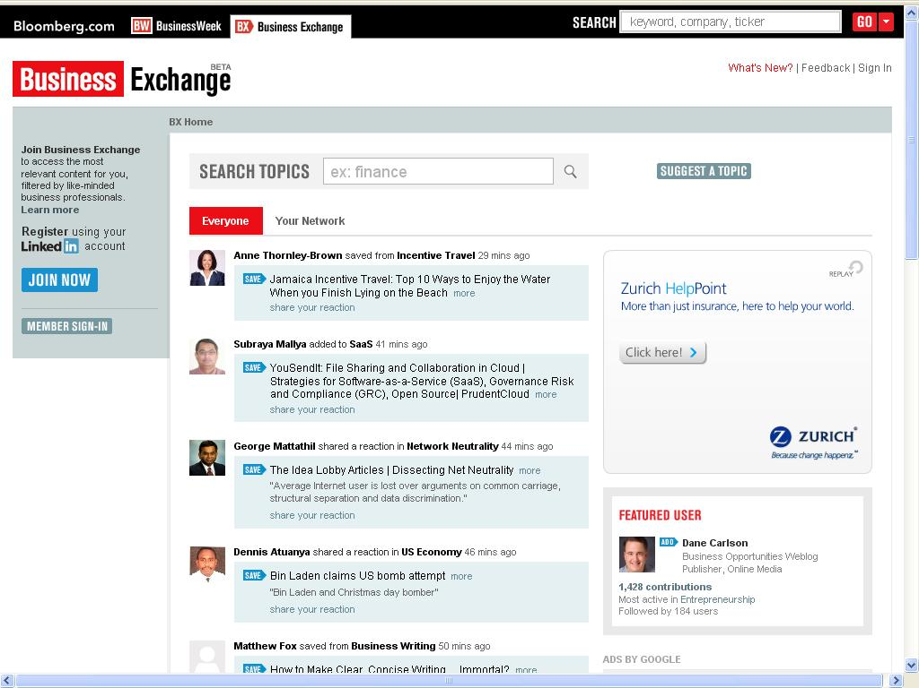
What is the Focus?
BusinessWeek targets managers and business executives.
Focusing their publications on international business news, emerging technologies, management, marketing, investments, and information technology.
Current Information Technologies
BusinessWeek provides a feature strip called the “belly band” to promote its blog, special reports, video, and reader engagement initiatives.
They stay current on the popular networking sites (Facebook, Twitter, etc), and also engage their readers with their self produced podcasts and blogs. These discuss the latest breaking technologies and are updated throughout the day.
Business Exchange: a site that acts as a hybrid between Twitter and Facebook to harness the power of web 2.0 groupthink.
Users submit content which creates a “hive mind” of business professionals.

Slide 4
benefits
BusinessWeek's Technology Section focuses on the cutting-edge technology relating to the business world. These technologies can include innovations from fields,such as Computers, Marketing Software, Energy Management, Internet Connectivity, CyberSecurity, and Economic Forecasting.
Business owners, IT professionals, and employees can benefit from the Technology Section’s focus on the “Computerized Office”
Details new innovations in computer hardware and software that is relevant to streamlining productivity and cutting costs.
Columns authored by individuals who specialize in different areas related to IT networking, management, marketing and investing.
CEO Tech Guide provides the key decision maker information on the latest IT innovations as well as ways to protect information critical for the success of the company.

Slide 5
Questions?

